Slide 1


Slide 2
Chapter 17
Introduction to Transaction Processing Concepts and Theory

Slide 3
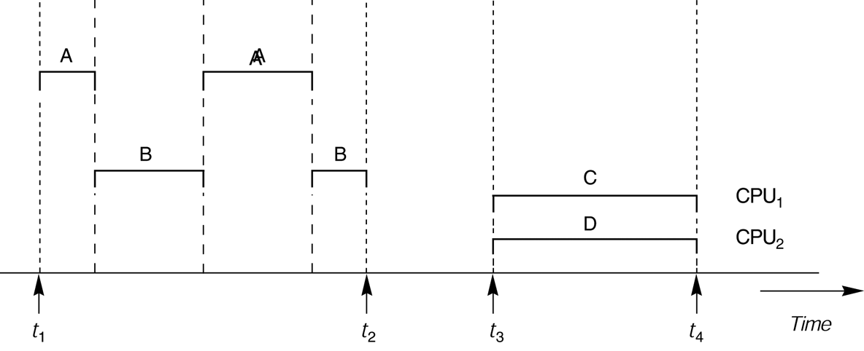
FIGURE 17.1
Interleaved processing versus parallel processing of concurrent transactions.

Slide 4

FIGURE 17.2
Two sample transactions. (a) Transaction T₁. (b) Transaction T₂.

Slide 5
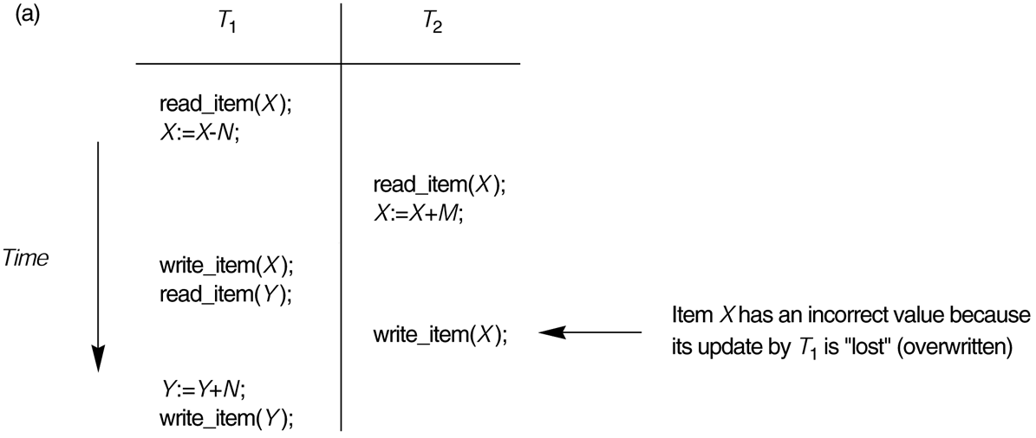
FIGURE 17.3
Some problems that occur when concurrent execution is uncontrolled. (a) The lost update problem.

Slide 6
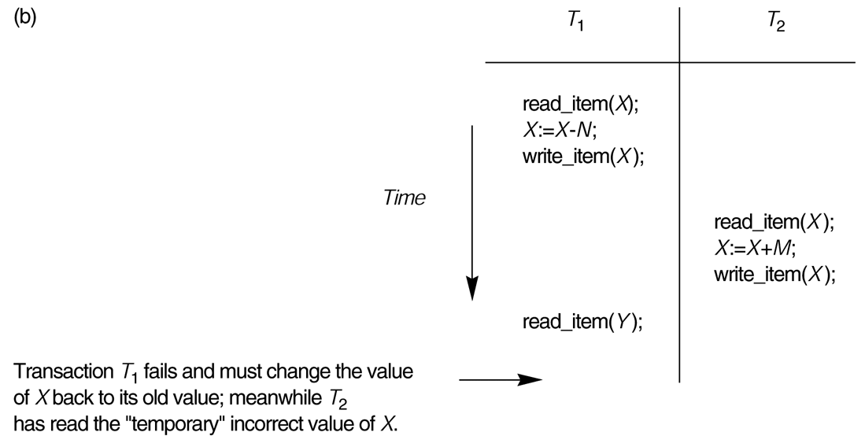
FIGURE 17.3 (continued)
Some problems that occur when concurrent execution is uncontrolled. (b) The temporary update problem.

Slide 7
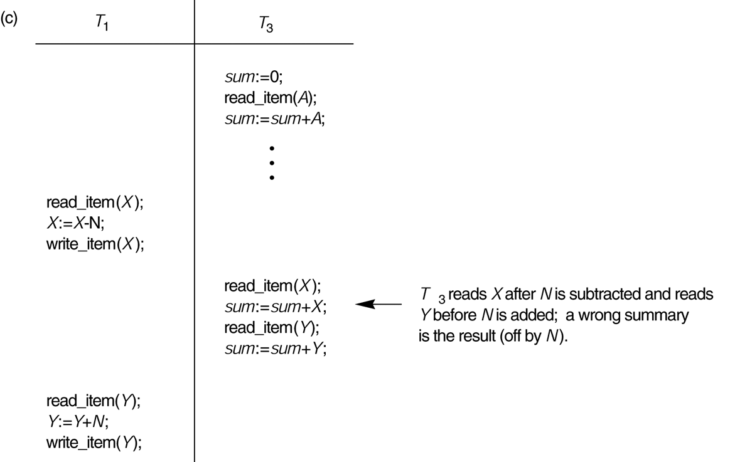
FIGURE 17.3 (continued)
Some problems that occur when concurrent execution is uncontrolled. (c) The incorrect summary problem.

Slide 8
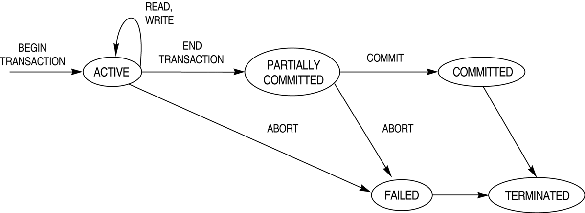
FIGURE 17.4
State transition diagram illustrating the states for transaction execution.

Slide 9
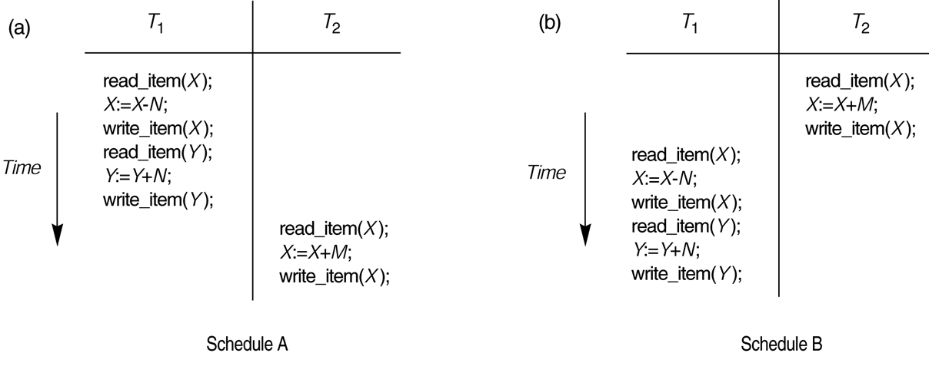
FIGURE 17.5
Examples of serial and nonserial schedules involving transactions T₁ and T₂. (a) Serial schedule A: T₁ followed by T₂. (b) Serial schedules B: T₂ followed by T₁.

Slide 10
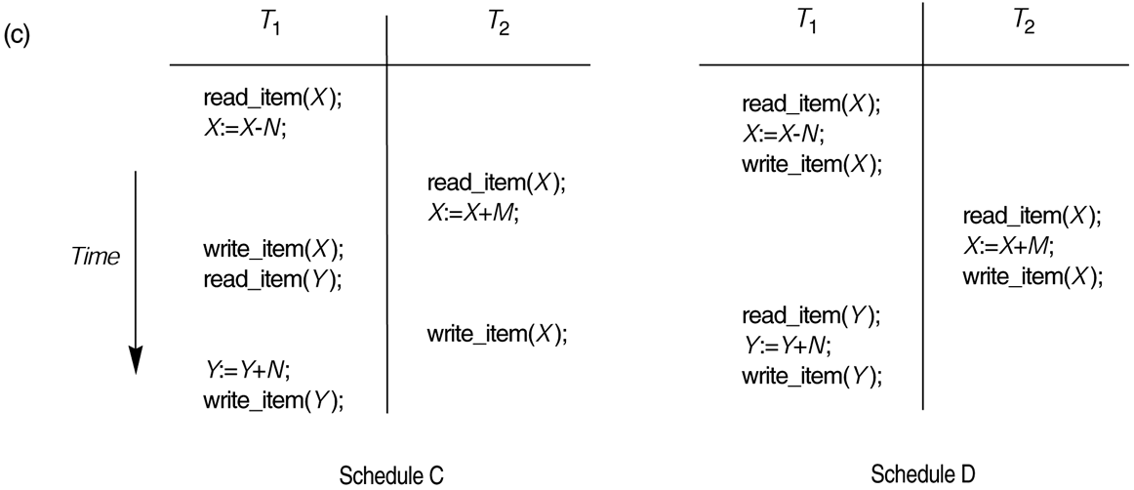
FIGURE 17.5 (continued)
Examples of serial and nonserial schedules involving transactions T₁ and T₂. (c) Two nonserial schedules C and D with interleaving of operations.

Slide 11
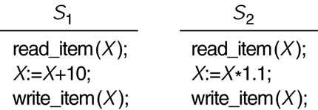
FIGURE 17.6
Two schedules that are result equivalent for the initial value of X = 100 but are not result equivalent in general.

Slide 12
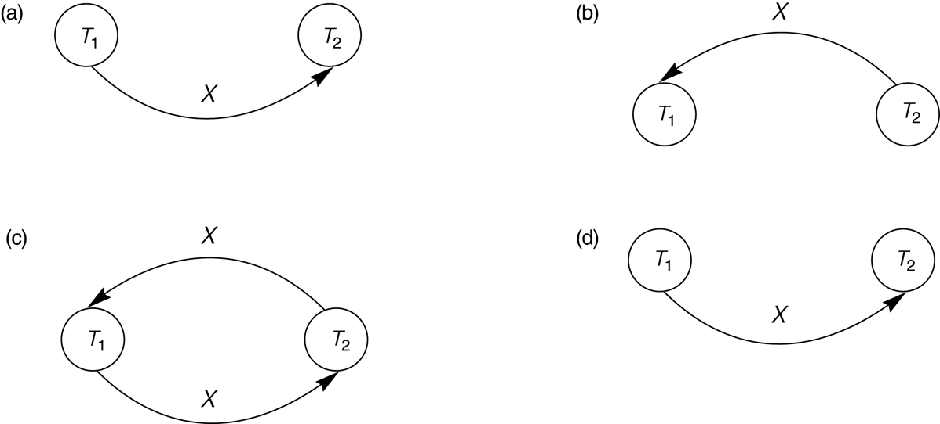
FIGURE 17.7
Constructing the precedence graphs for schedules A and D from Figure 17.5 to test for conflict serializability. (a) Precedence graph for serial schedule A. (b) Precedence graph for serial schedule B. (c) Precedence graph for schedule C (not serializable). (d) Precedence graph for schedule D (serializable, equivalent to schedule A).

Slide 13
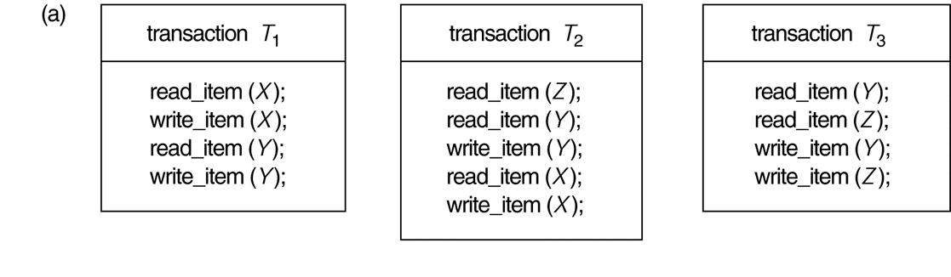
FIGURE 17.8
Another example of serializability testing. (a) The READ and WRITE operations of three transactions T₁, T₂, and T₃.

Slide 14
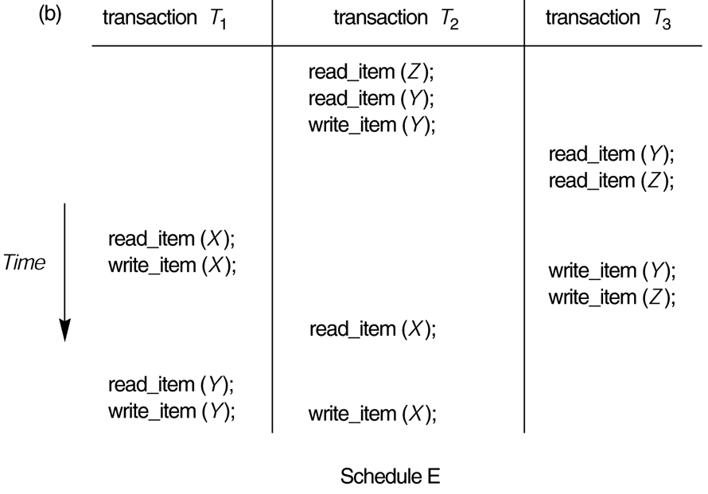
FIGURE 17.8 (continued)
Another example of serializability testing. (b) Schedule E.

Slide 15
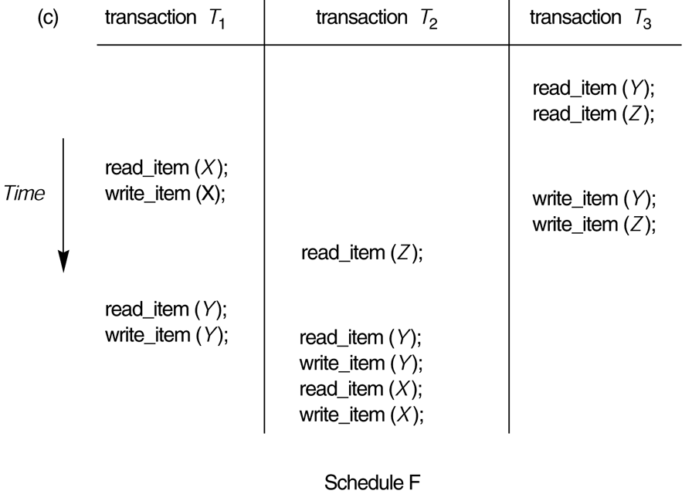
FIGURE 17.8 (continued)
Another example of serializability testing. (c) Schedule F.

Slide 16
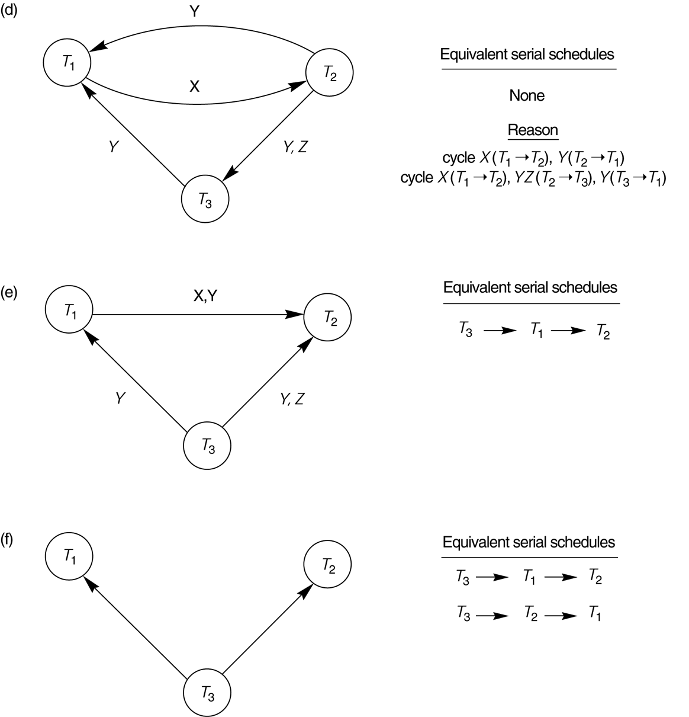
FIGURE 17.8 (continued)
Another example of serializability testing.
(d) Precedence graph for schedule E.
(e) Precedence graph for schedule F.
(f) Precedence graph with two equivalent serial schedules.

